Slide 1
Understanding Referential Coordination as a Particle Swarm Optimization Task
H. Chase Stevens
Supervisor: Dr. Hannah Rohde

Slide 2
Contents
Referential Coordination
Rohde et al. 2012
Particle Swarm Optimization
Modeling Referential Coordination using Particle Swarm Optimization

Slide 3
Referential Coordination

Slide 4
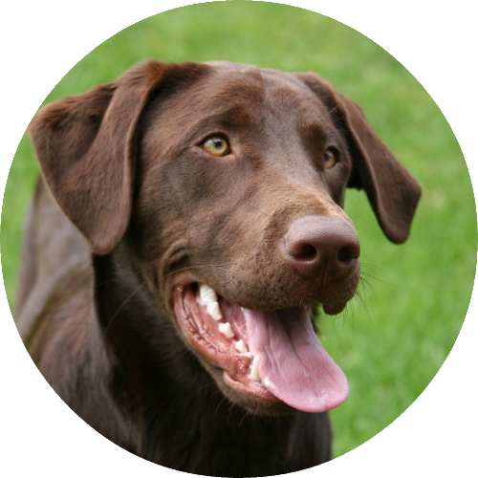
Referential Coordination
Chocolate lab

Slide 5

Referential Coordination
Chocolate lab
Corgi

Slide 6
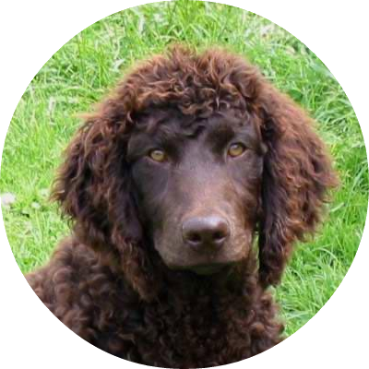
Referential Coordination
Chocolate lab
Corgi
American water spaniel / German longhaired pointer mix

Slide 7
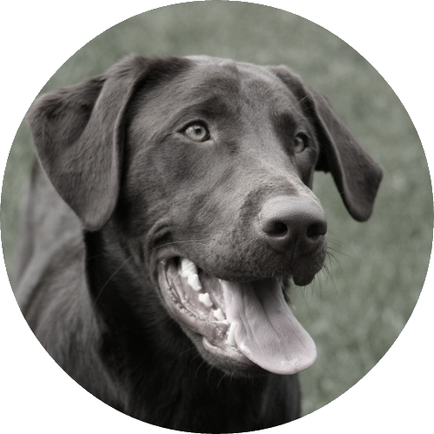
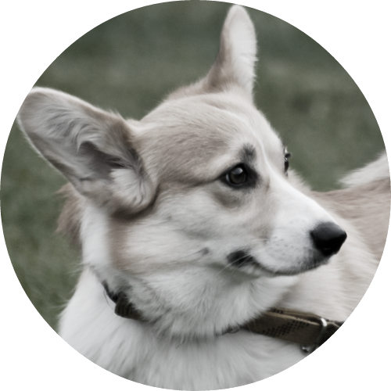
Referential Coordination
Chocolate lab
Corgi
American water spaniel / German longhaired pointer mix

Slide 8
Referential Coordination
Chocolate lab
Corgi
American water spaniel / German longhaired pointer mix
“That brown dog”

Slide 9
Referential Coordination
Chocolate lab
Corgi
American water spaniel / German longhaired pointer mix
“That brown dog”
“That brown dog”?

Slide 10
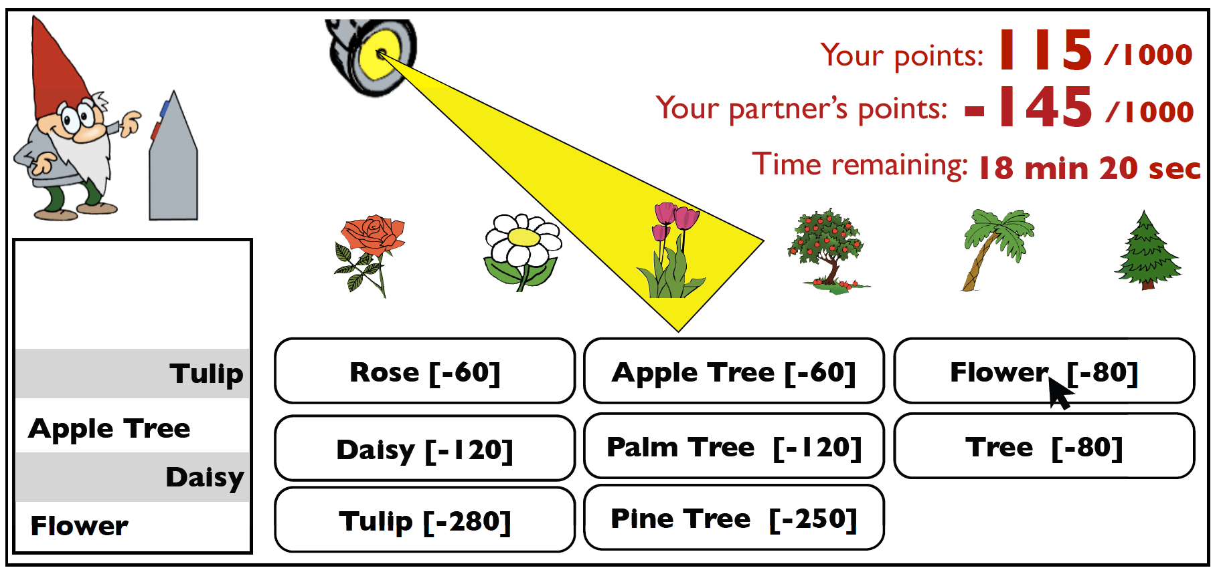
Rohde et al. 2012

Slide 11
Rohde et al. 2012
Name | Study 1 Cost | Study 2 Cost
“Flower” | 80 | 80
“Rose” | 60 | 80
“Daisy” | 120 | 140
“Tulip” | 280 | 165
“Tree” | 80 | 80
“Apple Tree” | 60 | 80
“Pine Tree” | 120 | 135
“Palm Tree” | 250 | 170

Slide 12
Particle Swarm Optimization

Slide 13
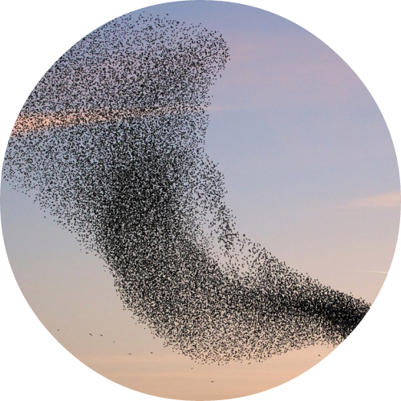
Particle Swarm Optimization
Bird flocking simulations
Heppner & Grenander.
(1990). A Stochastic Nonlinear Model for Coordinated Bird Flocks.

Slide 14

Particle Swarm Optimization
+
Bird flocking simulations
Heppner & Grenander.
(1990). A Stochastic Nonlinear Model for Coordinated Bird Flocks.
Human behaviour

Slide 15
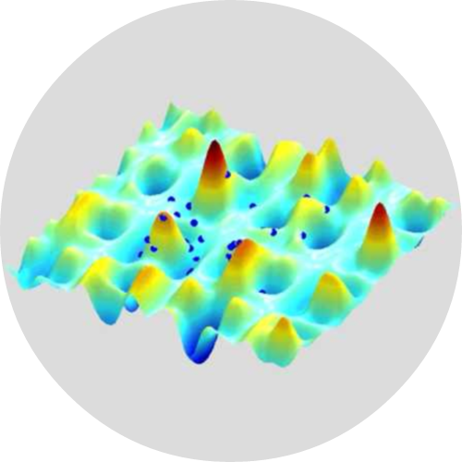
Particle Swarm Optimization
+
=
Bird flocking simulations
Heppner & Grenander.
(1990). A Stochastic Nonlinear Model for Coordinated Bird Flocks.
Human behaviour
PSO
Kennedy & Eberhart.
(1995). Particle Swarm Optimization.

Slide 16
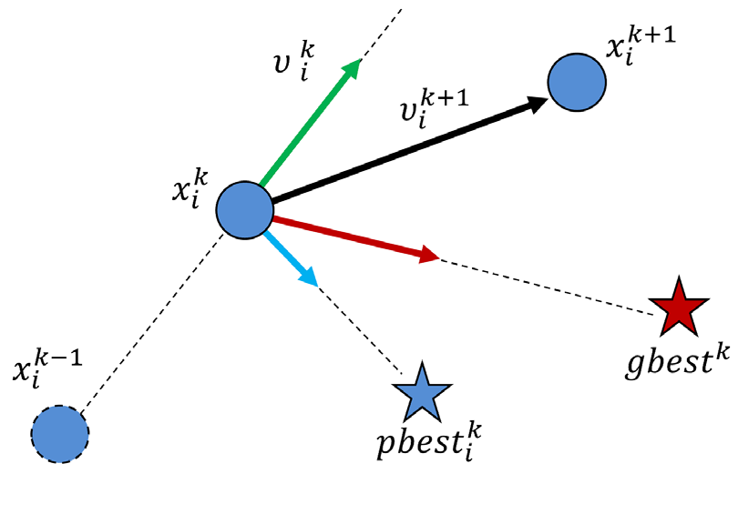
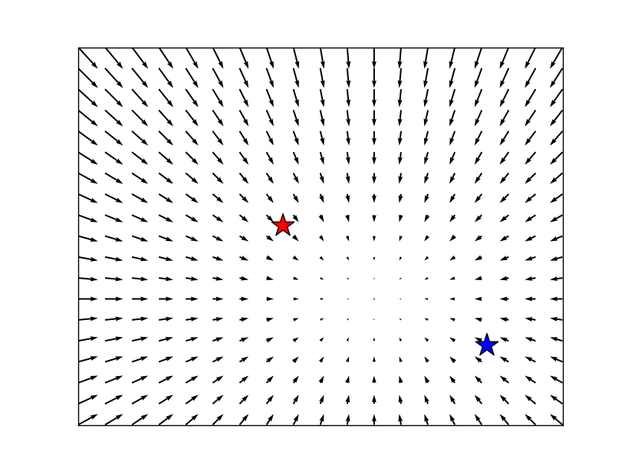
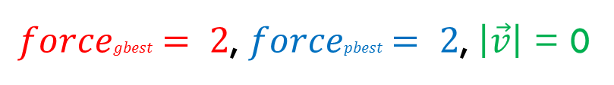
Particle Swarm Optimization
$forcegbest = 2$, $forcepbest = 2$, $\left|\vec{v}\right|$ = 0
Noto et al. (2013). Agent-based Social Simulation Model for Analyzing Human Behaviours using Particle Swarm Optimization.

Slide 17
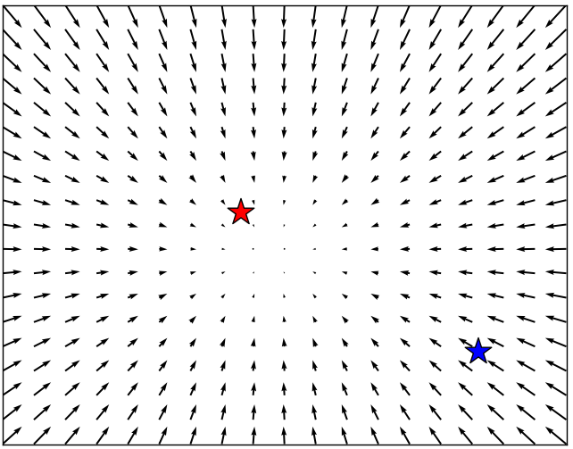
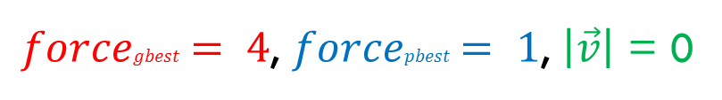
Particle Swarm Optimization
$forcegbest = 4$, $forcepbest = 1$, $\left|\vec{v}\right|$ = 0
Noto et al. (2013). Agent-based Social Simulation Model for Analyzing Human Behaviours using Particle Swarm Optimization.

Slide 18
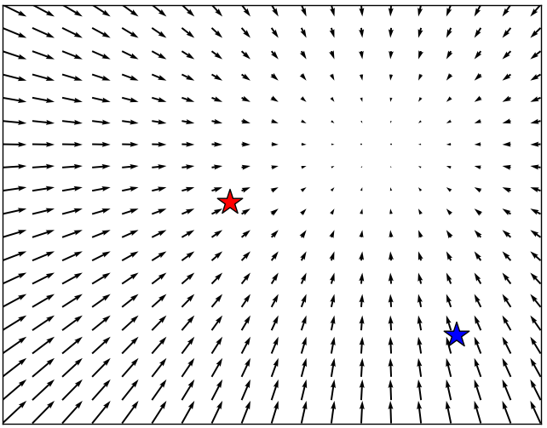
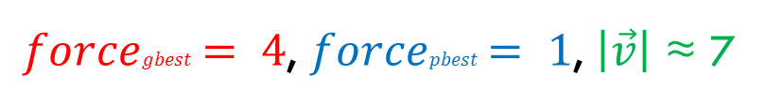
Particle Swarm Optimization
$forcegbest = 4$, $forcepbest = 1$, $\left|\vec{v}\right|$ ≈ 7
Noto et al. (2013). Agent-based Social Simulation Model for Analyzing Human Behaviours using Particle Swarm Optimization.

Slide 19
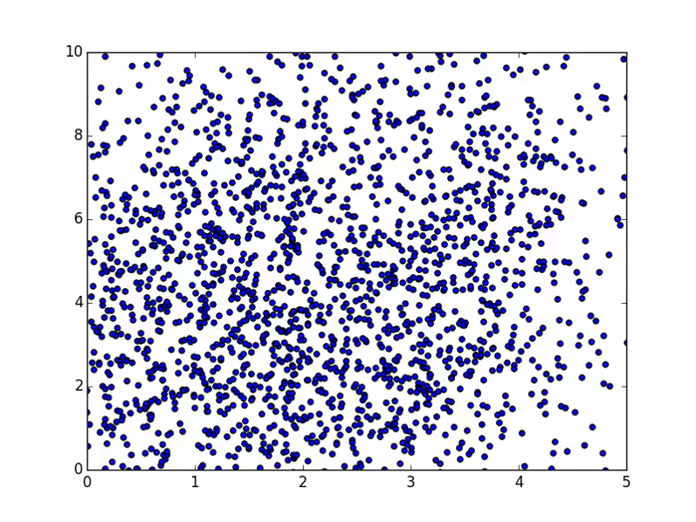
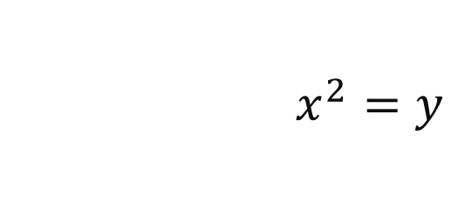
Particle Swarm Optimization
$$x^{2}=y$$
https://www.youtube.com/watch?v=7Cv40nljDHs

Slide 20
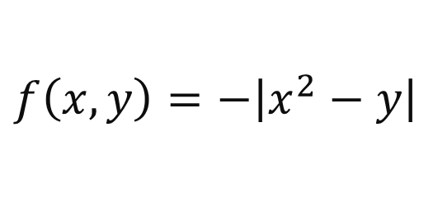
Particle Swarm Optimization
$$f\left(x, y\right)=−\left|x^{2}−y\right|$$
https://www.youtube.com/watch?v=7Cv40nljDHs

Slide 21

Particle Swarm Optimization
$$f\left(x, y\right)=−\left|x^{2}−y\right|$$
https://www.youtube.com/watch?v=7Cv40nljDHs

Slide 22
Applying PSO to referential coordination
Pair of interlocutors is group of two particles
Game strategy is expressed as three numbers, e.g.
Probability of using “Flower” for “Rose”
Probability of using “Flower” for “Daisy”
Probability of using “Flower” for “Tulip”

Slide 23
Applying PSO to referential coordination

Slide 24
Applying PSO to Referential Coordination

Slide 25
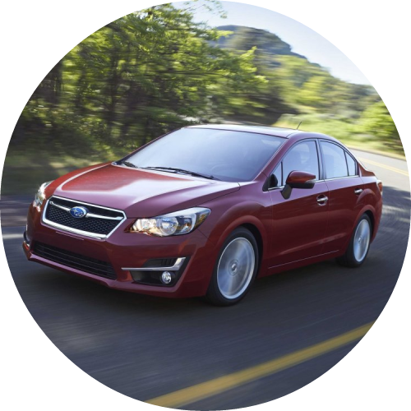
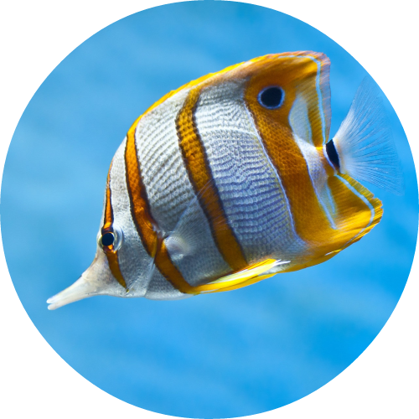
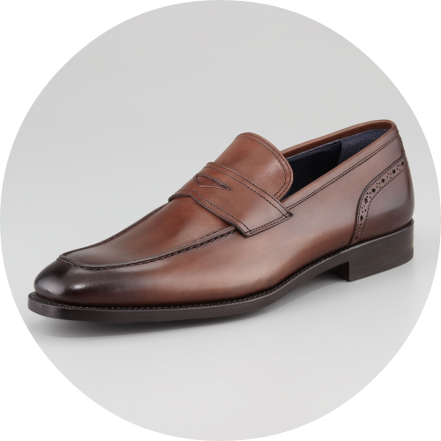
Applying PSO to Referential Coordination
Brennan & Clark. (1996). Conceptual Pacts and Lexical Choice in Conversation.

Slide 26
Applying PSO to Referential Coordination
Car
Brennan & Clark. (1996). Conceptual Pacts and Lexical Choice in Conversation.

Slide 27
Applying PSO to Referential Coordination
Car
Fish
Brennan & Clark. (1996). Conceptual Pacts and Lexical Choice in Conversation.

Slide 28
Applying PSO to Referential Coordination
Car
Fish
Shoe
Brennan & Clark. (1996). Conceptual Pacts and Lexical Choice in Conversation.

Slide 29
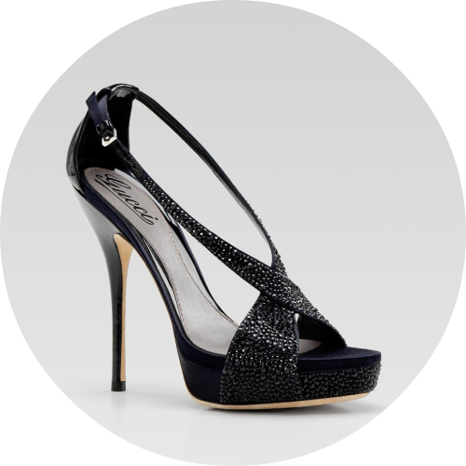
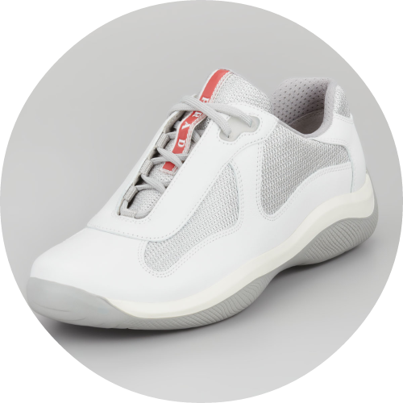
Applying PSO to Referential Coordination
Brennan & Clark. (1996). Conceptual Pacts and Lexical Choice in Conversation.

Slide 30
Applying PSO to Referential Coordination
High heel
Brennan & Clark. (1996). Conceptual Pacts and Lexical Choice in Conversation.

Slide 31
Applying PSO to Referential Coordination
High heel
Sneaker
Brennan & Clark. (1996). Conceptual Pacts and Lexical Choice in Conversation.

Slide 32
Applying PSO to Referential Coordination
High heel
Sneaker
Loafer
Brennan & Clark. (1996). Conceptual Pacts and Lexical Choice in Conversation.

Slide 33
Applying PSO to Referential Coordination
High heel
Sneaker
Loafer
Brennan & Clark. (1996). Conceptual Pacts and Lexical Choice in Conversation.

Slide 34
Applying PSO to Referential Coordination
Loafer
Brennan & Clark. (1996). Conceptual Pacts and Lexical Choice in Conversation.

Slide 35
Applying PSO to Referential Coordination
Car
Loafer
Brennan & Clark. (1996). Conceptual Pacts and Lexical Choice in Conversation.

Slide 36
Applying PSO to Referential Coordination
Car
Fish
Loafer
Brennan & Clark. (1996). Conceptual Pacts and Lexical Choice in Conversation.

Slide 37
Applying PSO to Referential Coordination
Car
Fish
Loafer
Brennan & Clark. (1996). Conceptual Pacts and Lexical Choice in Conversation.

Slide 38
References
Rohde et al. (2012). Communicating with Cost-Based Implicature: A Game-Theoretic Approach to Ambiguity.
Kennedy & Eberhart. (1995). Particle Swarm Optimization.
Brennan & Clark. (1996). Conceptual Pacts and Lexical Choice in Conversation.
Heppner & Grenander. (1990). A Stochastic Nonlinear Model for Coordinated Bird Flocks.
Engelbrecht. (2005). Fundamentals of Computational Swarm Intelligence.
Clark & Murphy. (1982). Audience Design in Meaning and Reference.
Horton & Keysar. (1996). When do Speakers Take into Account Common Ground?
Benz, Jäger & van Rooj. (2005). An Introduction to Game Theory for Linguists.
Noto et al. (2013). Agent-based Social Simulation Model for Analyzing Human Behaviours using Particle Swarm Optimization. Image credit.

Slide 39
Understanding Referential Coordination As a Particle swarm Optimization Task
Questions?
chase@chasestevens.com

